Slide 1
AME-504, Mechatronics System Engineering
Application Development Project​
Mini Soccer
Penalty Kick Game
Tianpai Le, Yuehan She & Renkun Wang
1

Slide 2
Table of Contents
Context & Project Goal | 3
Projectile Launcher Design | 6
Field & Goalkeeper Design | 13
Electronics & Software Design | 14
2

Slide 3

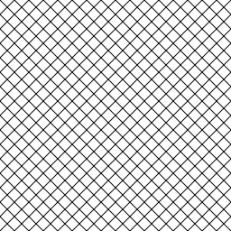

Context & Project Goal
Design a mini soccer game that imitates a penalty kick:
A projectile launcher shoots a ball towards the goal
Launcher can be controlled by player
A moving obstacle acting as the goalkeeper
3

Slide 4
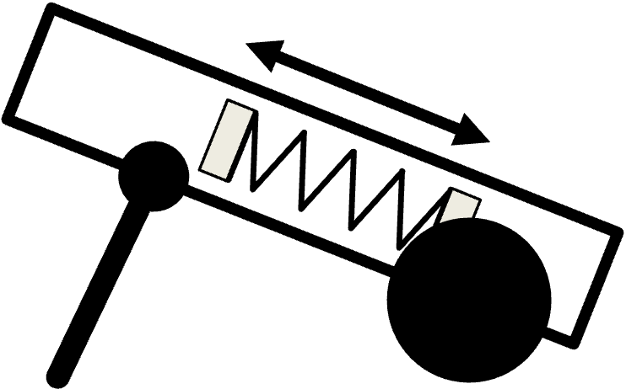
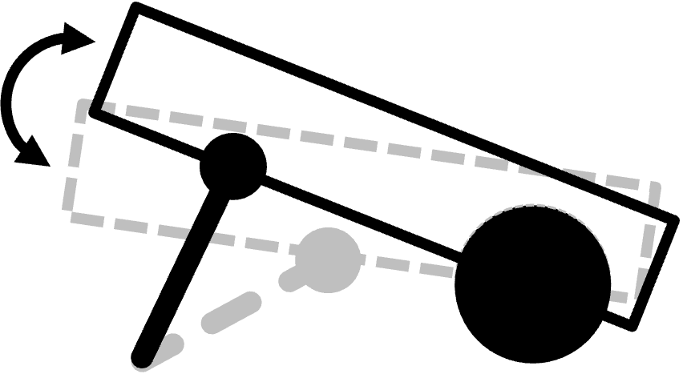
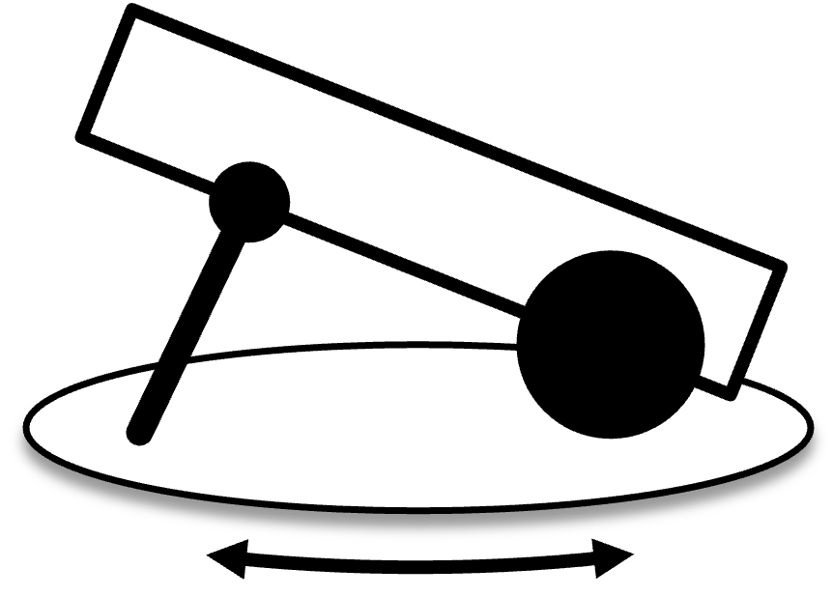
Context & Project Goal
Projectile Launcher: 3-DOF System
X-Translation
(adjustable force)
Y-Rotation
Z-Rotation
Moving Goalkeeper
Operated by remote control
4

Slide 5
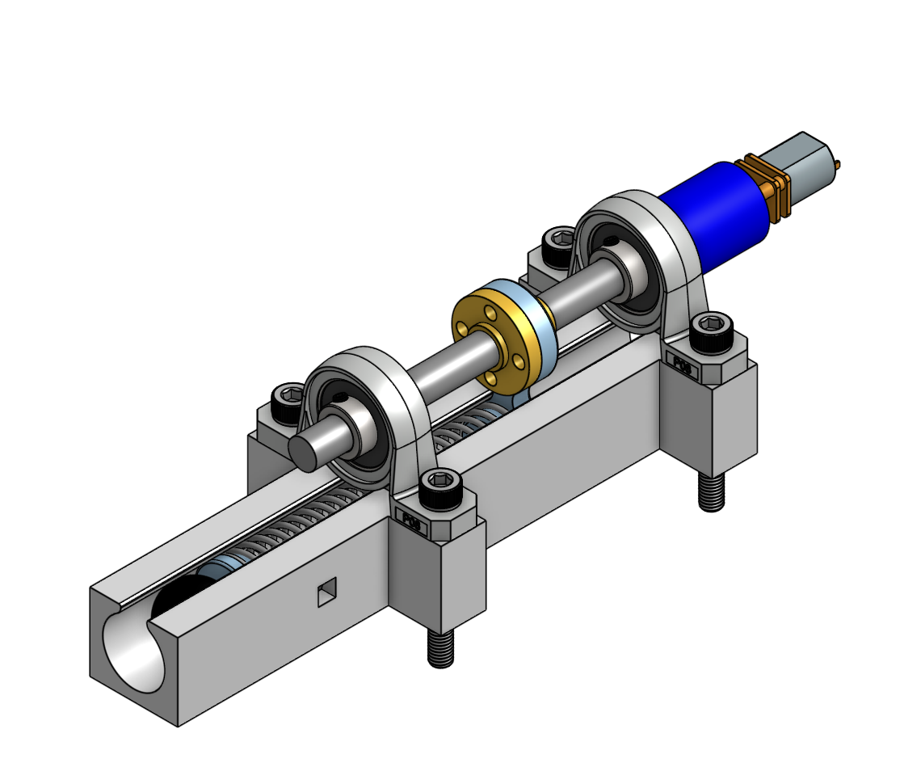
Projectile Launcher: X-Translation Design
Linear Screw
Sliding Rail
N20 DC Motor
Front Slider
Nut & Rear Slider
Compression Spring
Trigger
5

Slide 6









Projectile Launcher: X-Translation Design
Spring Equations
Elastic Potential Energy:
$$U=\frac{1}{2}k{\left(∆L\right)}^{2}=\frac{{\left(F_{max}\right)}^{2}}{2k}$$
Conversion to Ball Kinetic Energy:
$$K_{E}=ηU=\frac{1}{2}mV^{2}$$
Ball Instantaneous Positions:
$$x=x_{0}+V_{x}t=x_{0}+Vcos\left(θ\right)t$$
$$y=y_{0}+V_{y_{0}}t=y_{0}+Vsin\left(θ\right)t−\frac{1}{2}gt^{2}$$
$$k$$
-- Spring Rate
$$F_{max}$$
-- Maximum Load
$$η$$
-- Efficiency (assume 25%)
$$V$$
-- Initial Projectile Velocity
$$θ$$
-- Projectile Angle
6

Slide 7
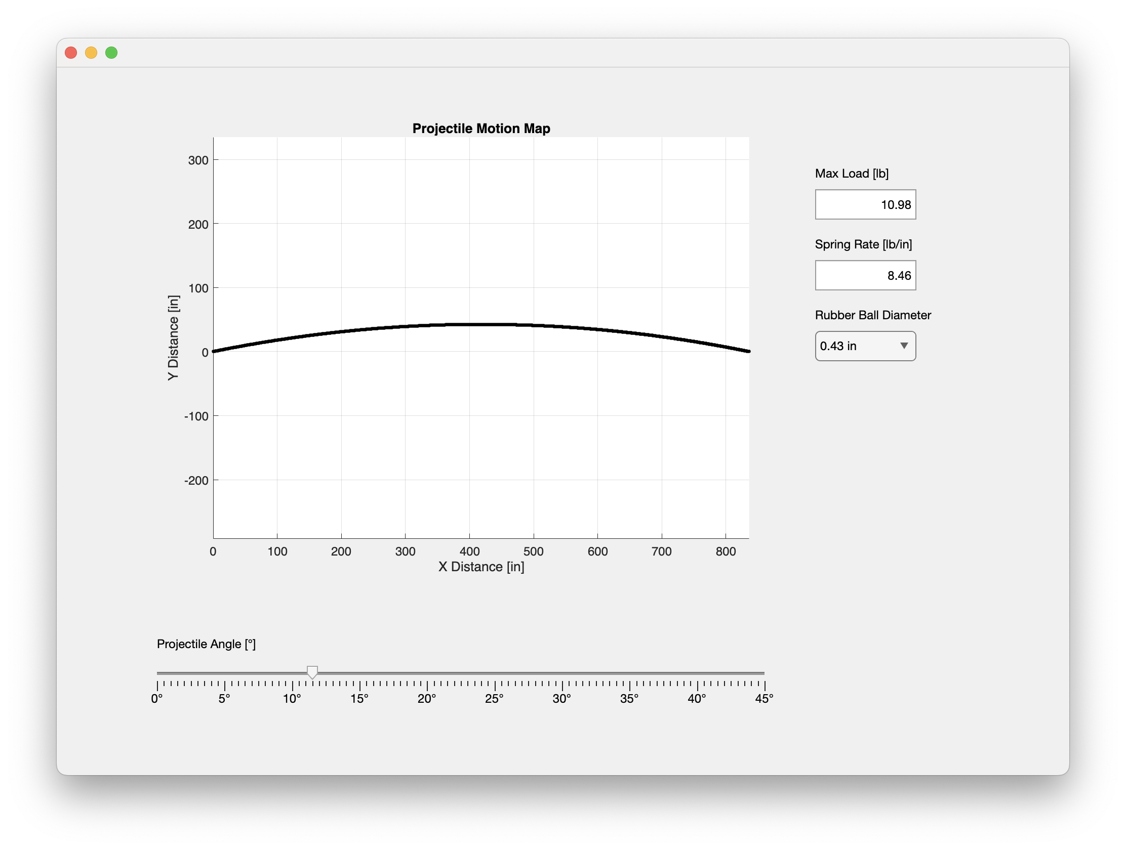
Projectile Launcher: X-Translation Design
MATLAB Calculator: Projectile Motion
Available rubber ball diameters:
0.43’’
0.5’’
0.68’’
7

Slide 8
Projectile Launcher: X-Translation Design
Spring Selection
Criteria:
Longer adjustable length
Shorter shooting distance
No. | Spring Name | Neutral Length | Outside Diameter | Max Load [lb] | Spring Rate [lb/in] | Adjustable Length | Rubber Ball Diameter | Max Distance @ 30° [in]
1 | 9657K228 | 3.5'' | 0.375'' | 2.87 | 2.87 | 1'' | 0.43'' | 350-400
2 | 9657K226 | 3.5'' | 0.438'' | 4.77 | 3.25 | 1.47'' | 0.43'' | 900-1000
3 | 9657K115 | 3'' | 0.5'' | 6.15 | 3.77 | 1.63'' | 0.5'' | 800-900
4 | 9657K221 | 4.5'' | 0.563'' | 11.15 | 5.16 | 2.16'' | 0.5'' | 1600-1800
5 | 9657K126 | 3'' | 0.593‘’ | 7.49 | 4.59 | 1.631‘’ | 0.5'' | 1000-1100
6 | 9657K432 | 3'' | 0.6'' | 7.3 | 3.1 | 2.38'' | 0.68'' | 500-600
7 | 9657K449 | 3.5'' | 0.6'' | 7.3 | 2.7 | 2.79'' | 0.68'' | 600-700
8 | 9620K57 | 3'' | 0.656'' | 9.38 | 7 | 1.34'' | 0.68'' | 400-450
9 | 9657K124 | 3'' | 0.688'' | 3.56 | 1.9 | 1.871 | 0.68'' | 200-220
Source: McMaster-Carr
8

Slide 9
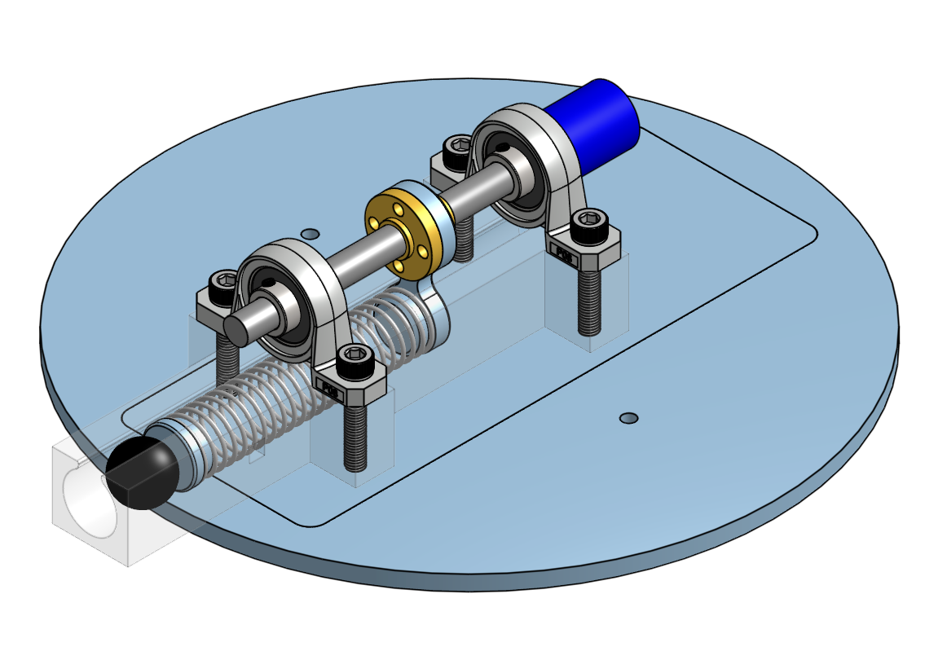
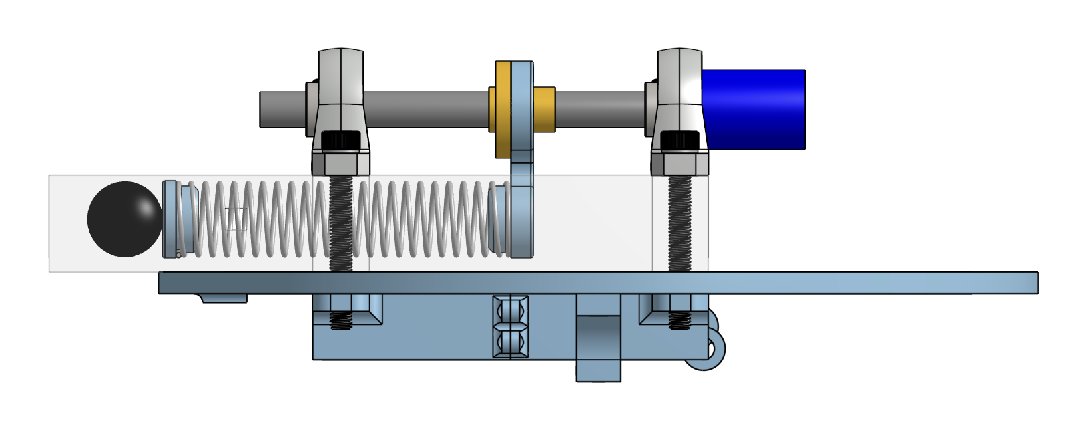
Projectile Launcher: Y-Rotation Design
Roller
Y-Rotation Board
Track
9

Slide 10
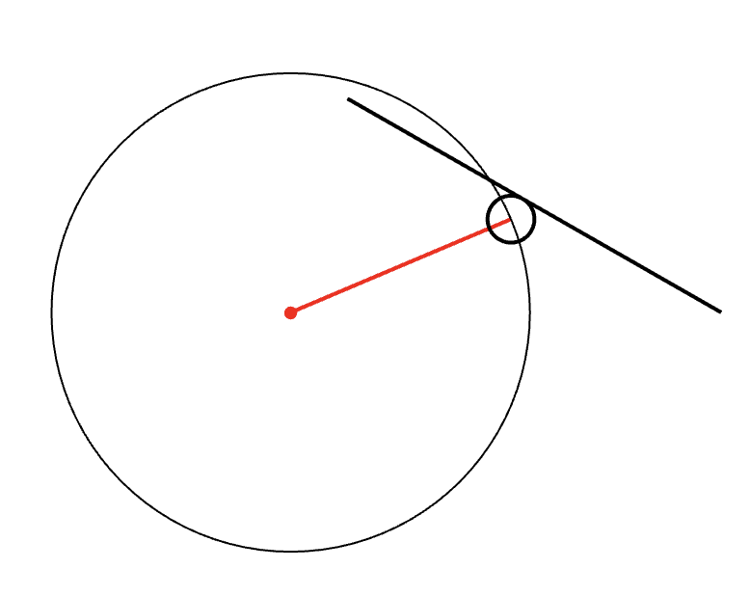



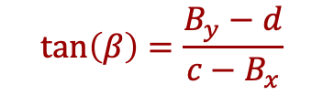






Projectile Launcher: Y-Rotation Design
Geometric Equations for Linkages
Point B Coordinates:
$$β$$
$$B_{x}=a+rsin(β)$$
$$A(a,b)$$
$$B$$
$$B_{y}=b+rcos(β)$$
$$α$$
$$β$$
Projectile Elevation Angle, β
$$O(0,0)$$
$$C(c, d)$$
$$\tan\left(β\right)=\frac{B_{y}−d}{c−B_{x}}$$
$$r$$
-- Roller Radius
10

Slide 11
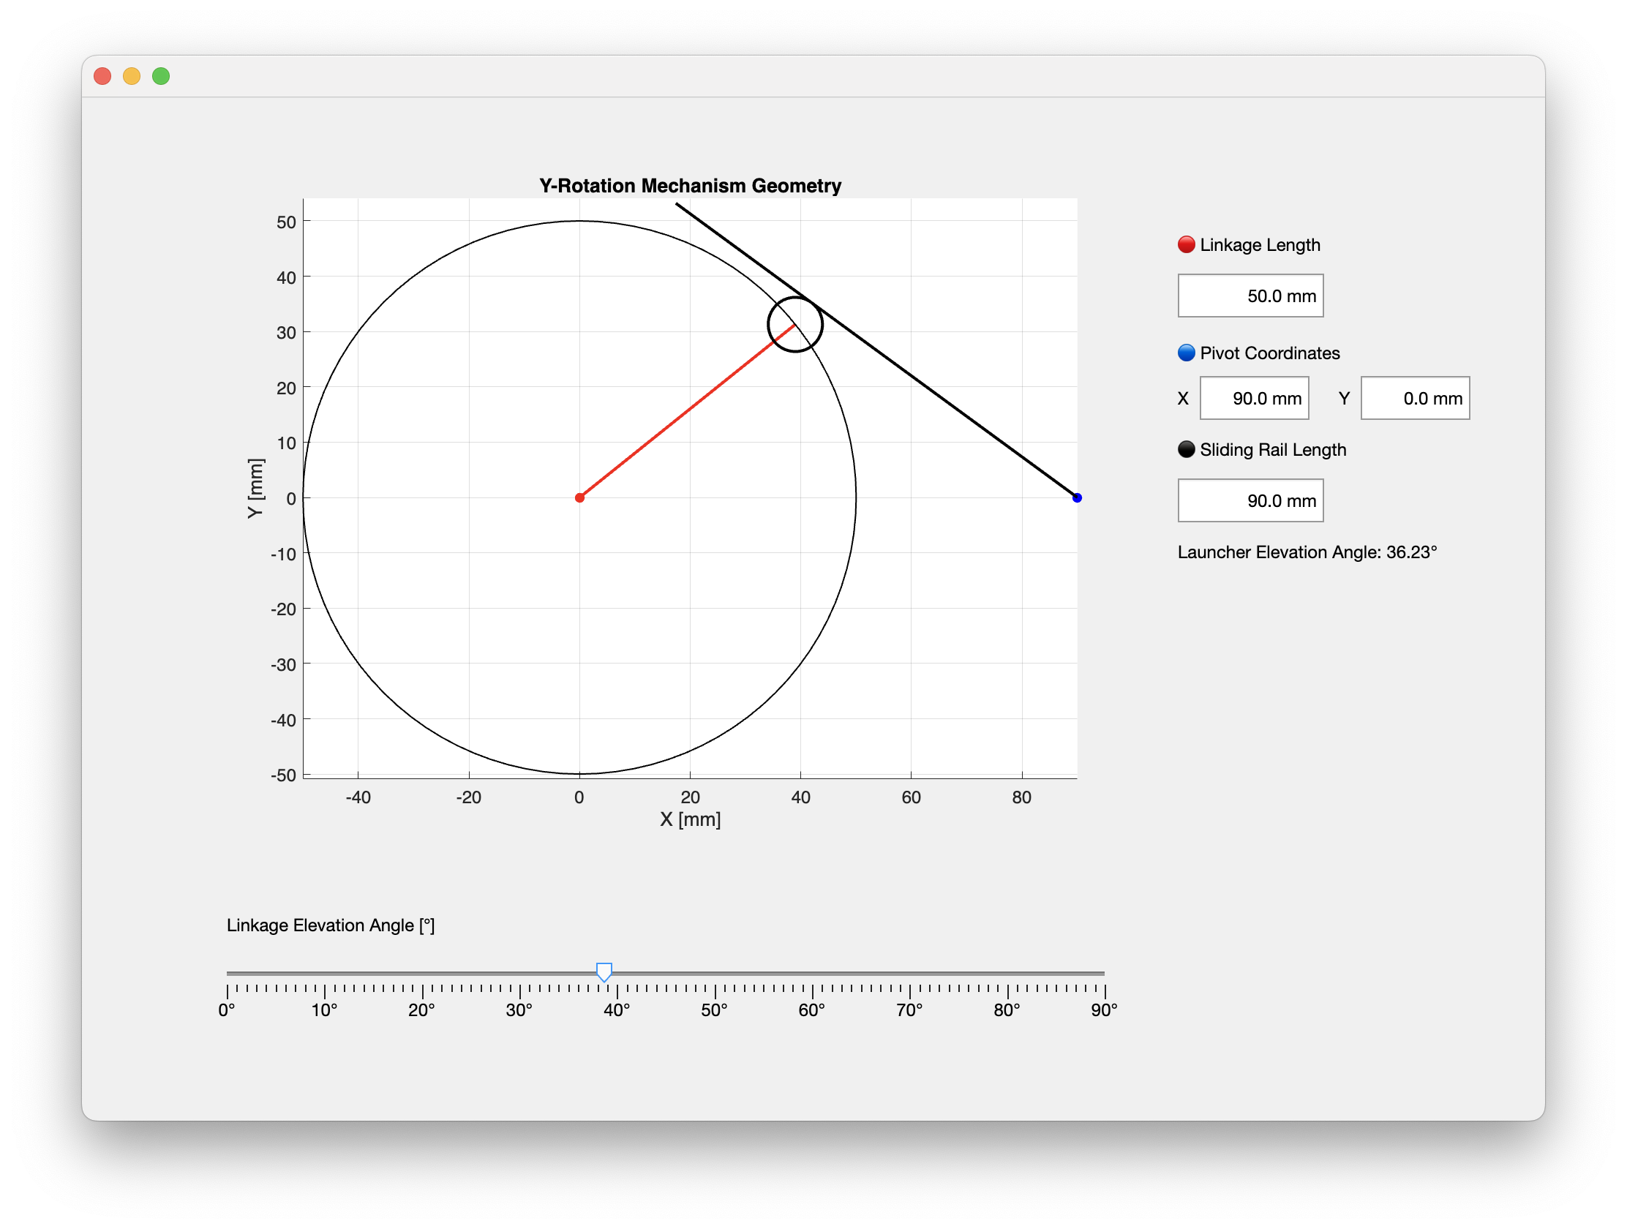
Projectile Launcher: Y-Rotation Design
MATLAB Calculator: Y-Rotation Mechanism Geometry
11

Slide 12
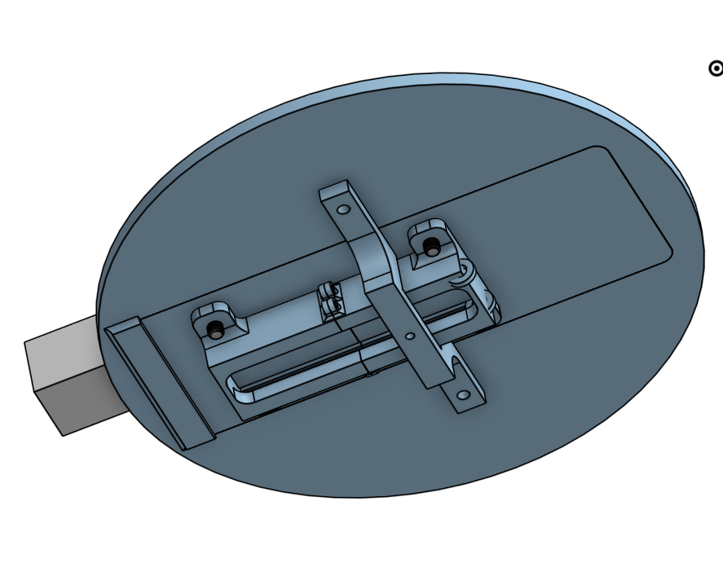
Projectile Launcher: Z-Rotation Design
Position of Structural Support for Stability
Motor Position
12

Slide 13
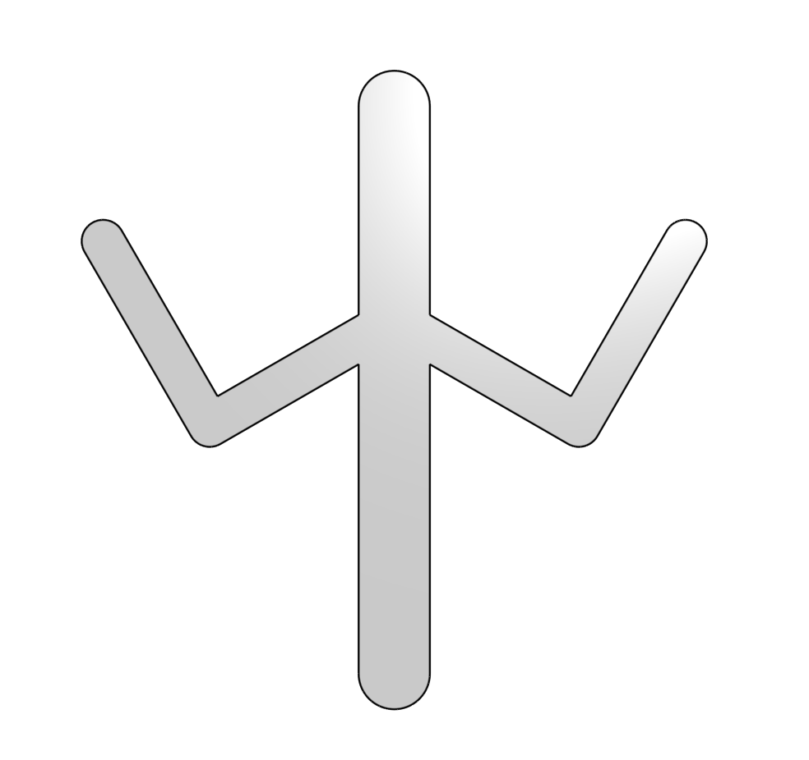
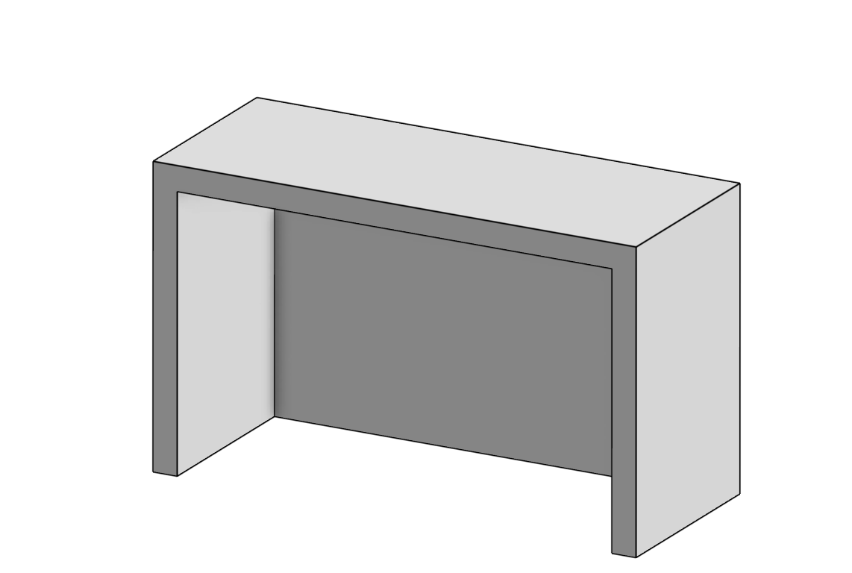
Field & Goalkeeper Design
Goalkeeper
Field & Goal
13

Slide 14
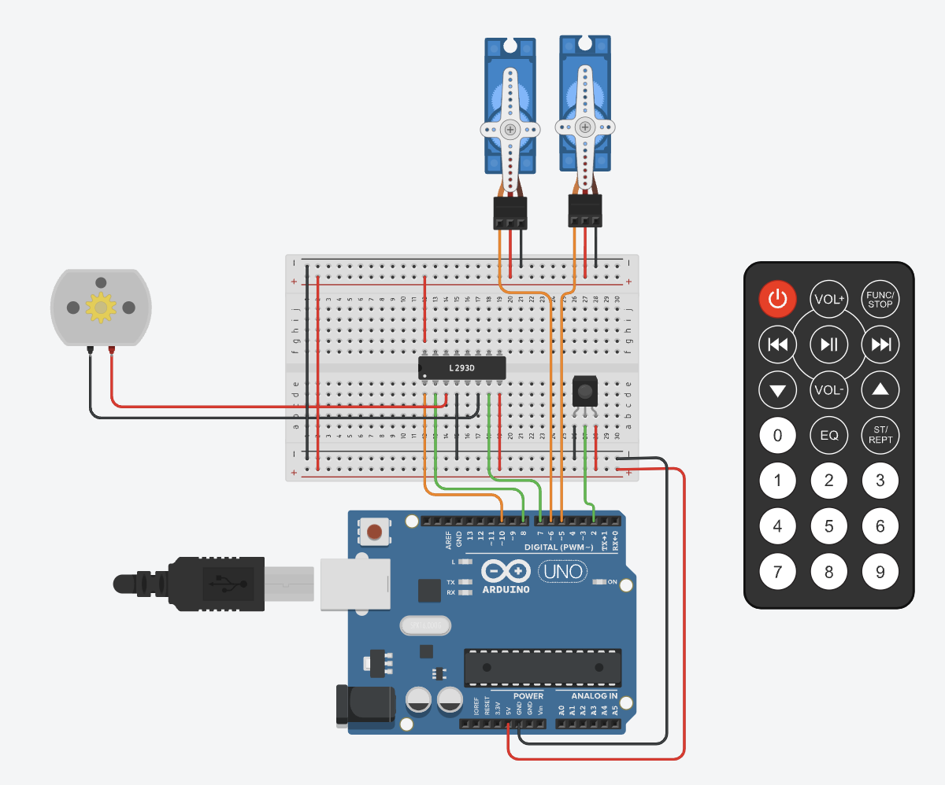
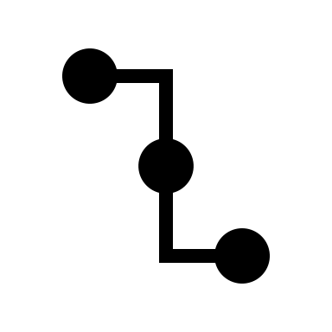
Electronics & Software Design
Schematic
Rotation Servos
X-Translation Motor
IR Receiver
Power
Ground
Digital
PWM
Arduino Board
Remote Control
14

Slide 15


Start
Z-Rotation
Y-Rotation
X-Translation
Launch
Goal Sensor & Display
Electronics & Software Design
Timer
(stop automatically if button not pressed)
Logic Process
Power Button
Play/Pause Button
15

Slide 16
Thank you for Listening!
Q&A
16

